Slide 1




QQMA GHANA LBG
QQMA STUDIOS
QQMA HEALTH
QQMA OUTREACH
QQMA EDU.
QQMA CARE
QUALITY QUANTITY MENTAL ATTITUDE LBG
QQMA STUDIOS
BELIEVE AND MAKE IT HAPPEN

Slide 2



ABOUT QQMA GHANA LBG
QUALITY QUANTITY MENTAL ATTITUDE (QQMA ) is a NOT- FOR PROFIT organization that aspires to provide support for the underprivileged and deprived, PRODUCE AND NURTURE positive minds to leverage available resources towards BUILDING a sustainable and self reliant Ghana.
FOUNDER: EMMANUEL FRENCH
DATE:20TH SEPTEMBER,2025
QQMA, BELIEVE AND MAKE IT HAPPEN

Slide 3
OUR VISION
OUR ULTIMATE VISION SHALL BE TO PRODUCE AND NURTURE POSITIVE MINDS TO LEVERAGE AVAILABLE RESOURCES TO build A SUSTAINABLE AND A SELF-RELIANT GHANA.

Slide 4
OUR MISSION
THE MISSION OF QQMA GHANA SHALL BE TO PROVIDE SUPPORT AND EQUAL OPPORTUNITIES FOR THE GHANAIAN CITIZEN .

Slide 5
GENERAL OBJECTIVES
Contribute to community and national development through communal initiatives.
CREATE A PLATFORM FOR PEOPLE TO SHOWCASE THEIR TALENTS AND POTENTIALS.
BRIDGE OPPORTUNITIES FOR STRIVING TALENT TO BE UPGRADED.
EMPOWER CITIZENS THROUGH TALKS AND SEMINARS ON THE RELEVANCE of HARD WORK AND P0sitive MINDS.

Slide 6
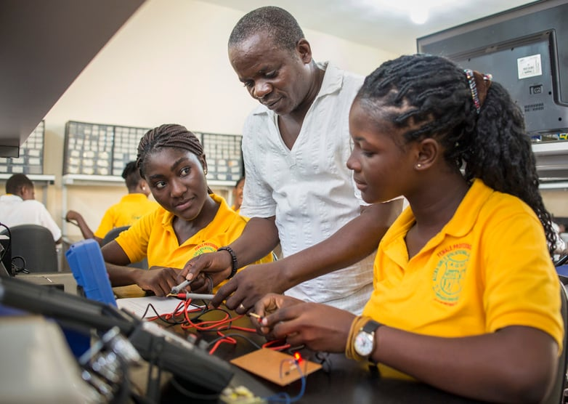
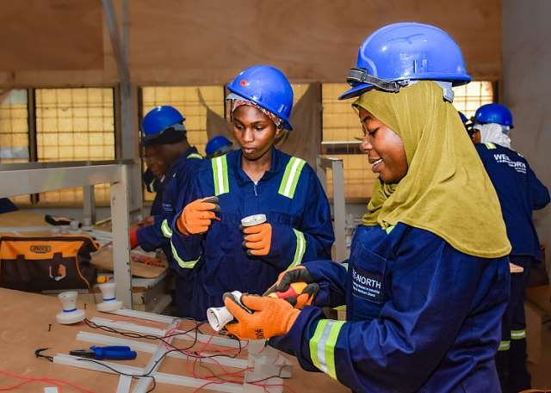
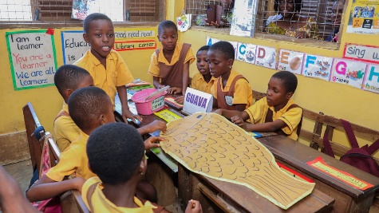
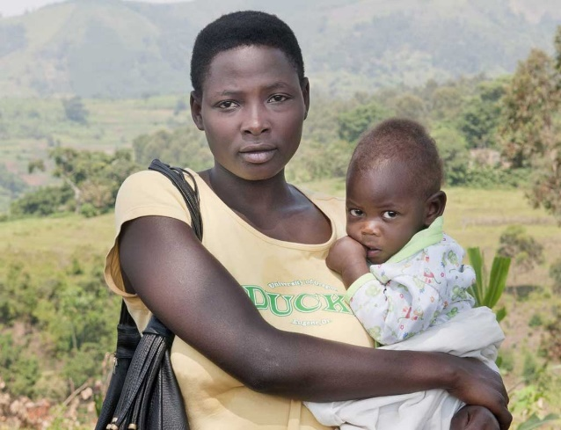
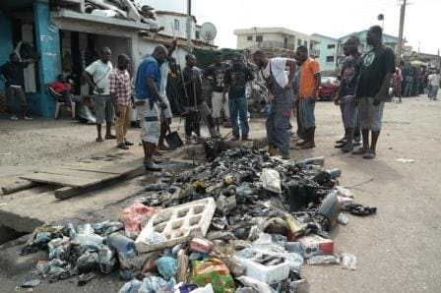
GOALS
PROVIDE EDUCATIONal support AND SKILL TRAINING TO 1000 UNDERPRIVILEGED YOUTH IN ACCRA BY AUGUST 2030 .
REDUCE STREETISM ,TEENAGE PREGNANACY AND CHILD LABOUR BY 40% IN ACCRA by august 2030.
PROMOTE ENVIRONMENTAL SUSTAINABILITY BY HELPING TO MANAGE THE DISPOSAL OF WASTE ESPECIALLY OUR BEACHES .

Slide 7





DIVISIONS OF QQMA
OUR CORE VALUES
INTEGRITY
POSITIVE MENTAL ATTITUDE
TEAMWORK
ACCOUNTABILITY
INCLUSIVENESS

Slide 8




QQMA CARE
The QQMA Care Division is a social support and empowerment initiative dedicated to improving the lives of Ghanaians through financial support, skills development, employment opportunities, insurance, and community-based assistance.
          KEY BENEFITS & SUPPORT
Business Support: Loans/grants to support viable businesses and entrepreneurs.
Job Opportunities: Employment and career opportunities through QQMA networks and partnerships.
Skills Development: Free skills training, seminars and workshops.
Networking: Connect individuals with professionals, businesses and opportunities.
Community Support: Assistance for individuals and communities in need.
Membership Benefits: Registered QQMA members and volunteers will receive additional benefits like group insurance and more.
QQMA — Believe and Make It Happen

Slide 9



QQMA EDUCATION
QQMA EDUCATION is the education division of QQMA, committed to improving educational opportunities and empowering children and young people across Ghana.
OUR FOCUS
Spelling Bee & Academic Competitions
STEM & Innovation
Teacher Development
Career & Skills Development
Student Support & Scholarships
BENEFITS
Improve academic performance
Build confidence and leadership
Develop creativity and critical thinking
Promote STEM and innovation
Create opportunities for disadvantaged learners
Support schools, teachers and communities.
OUR SPELLING BEE COMPETITION
OUR STEM FAIR
OUR INTERSCHOOL FOOTBALL COMPETITION

Slide 10
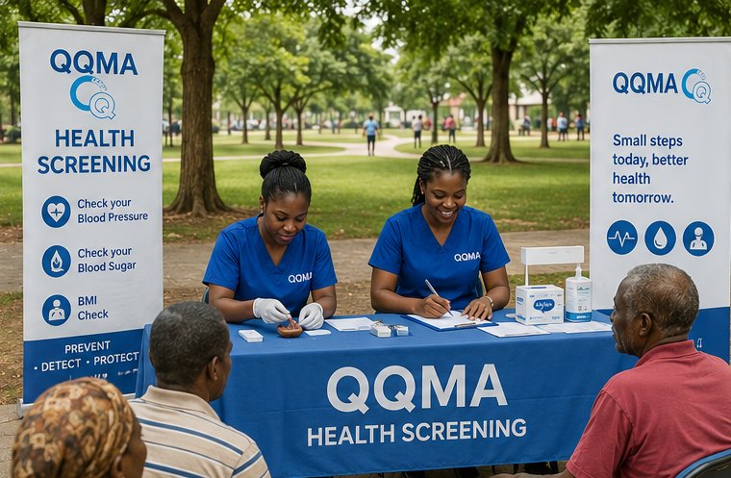
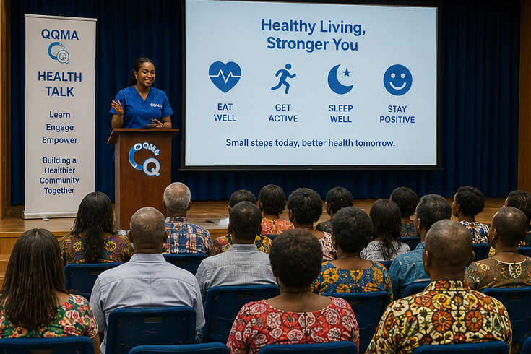
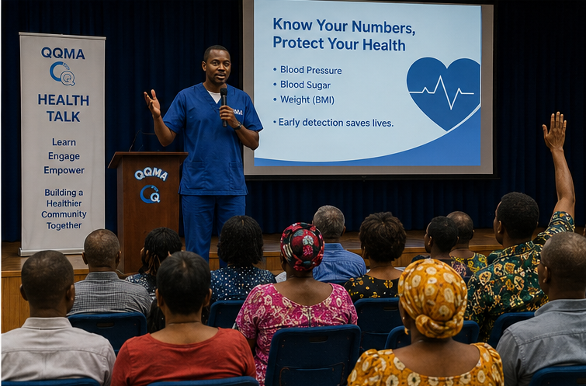
QQMA HEALTH
THE QQMA HEALTH is a division that committed to promoting healthier communities by supporting preventive healthcare, health education, wellness initiatives, and access to essential health services through partnerships and community engagement.
QQMA Health seeks to improve the physical, mental, and social well-being of individuals while encouraging healthy lifestyles.
Key Benefits
FREE AND ACCESSIBLE HEALTH SCREENING – Basic checks such as blood pressure, blood sugar etc.
EARLY DETECTION – We identify potential health concerns early and seek appropriate medical attention.
HEALTH EDUCATION – Health talks on nutrition, exercise, hygiene, lifestyle and disease prevention.

Slide 11

QQMA Studios is the creative and talent-development division of QQMA, dedicated to
identifying, nurturing and showcasing talents while using media, entertainment and sports to inspire young people and create opportunities.
Discover the Talent. Develop the Potential. Showcase the Impact.
QQMA STUDIOS

Slide 12

QQMA OUTREACH

Slide 13
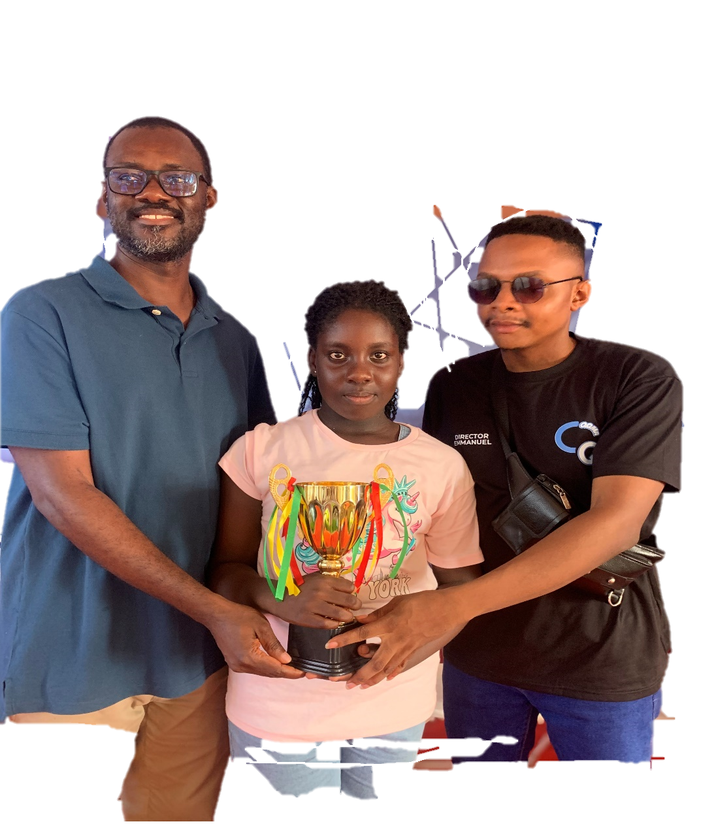
ACHEIVEMENTS AND
2026 PROJECTIONS
OPERATION DI WO HO NI (THE BEACH PROJECT) – PROVISIONAL DATE 26th SEPTEMBER,2026
QQMA HEALTH TALK IN SCHOOLS AND ORGANISATIONS.
ADDICTIONS (QQMA HEALTH AND CARE TEAM)
WASTE MANGEMENT (QQMA HEALTH AND CARE TEAM)
QQMA OUTREACH EVANGELISM AND DONATIONS(FOSTER HOMES AND VILAGES).
QQMA INTERSCHOOLS SPELLING BEE 2026 ACCRA AND KUMASI (DECEMBER).
QQMA INTERCHOOLS FOOTBALL COMPETITION 2026(SEPTEMBER)
SPELLING BEE CHAMPION 2025.
NAME:VALERIE LARTEY
CLASS : BASIC 6
SCHOOL:INTEGRITY ACADEMY

Slide 14


OPERATION DI WO HO NI
FLOAT: 19TH SEPTEMBER,2026
CLEAN UP DAY: 26TH SEPTEMBER,2026
THEME: WORKING TOGETHER TO RESTORE HOPE
QQMA , BELIEVE AND MAKE IT HAPPEN !!!!!!
QQMA STUDIOS

Slide 15

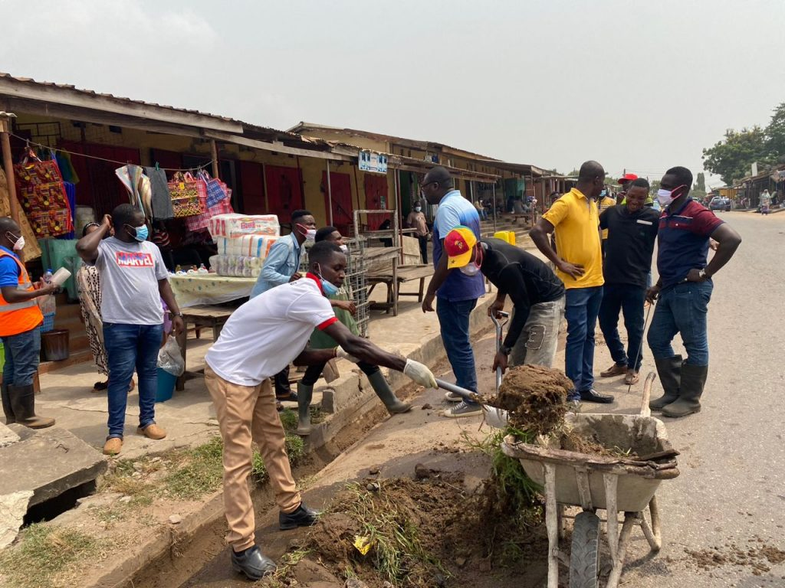
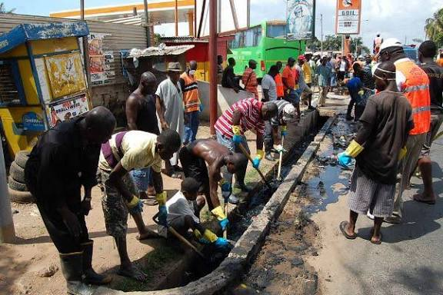
                INTRODUCTION
ABOUT
THE QQMA ‘OEPRATION DI WOHO NI’ INITIATIVE IS A COMMUNITY-BASED AND SENSITISATION PROGRAM WHICH IS FOCUSED ON CLEANLINESS ,DISCIPLINE AND COMMUNITY OWNERSHIP.
THIS EVENT WOULD BE MAINLY FACILITATED BY QQMA, VOLUNTEERS ,PARTNERS ,SPONSORS ,LOCAL AUTHORITIES AND ASSEMBLIES.

Slide 16

  OBJECTIVES
PROMOTE ENVIRONMENTAL CLEANLINESS AND SOCIAL RESPONSIBLITY .
REDUCE HEALTH RISKS CAUSED BY REFUSE IN ACCRA .
EDUCATE COMMUNITIES ON SANITAION AND WASTE MANAGEMENT PRACTICES.
BUILD A CULTURE OF CLEANLINESS.
ENCOURAGE YOUTH PATICIPATION AND LEADERSHIP IN ENVIRONMENTAL INITIATIVES.

Slide 17

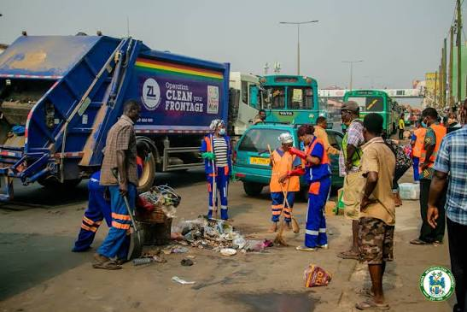

Target communities AND BENEFICIARIES
THE MAIDEN ‘OPERATION DI WO HO NI’ CLEAN UP EXERCISE WILL FOCUS ON COMMUNITIES WITH SANITATION CHALLENGES IN THE GREATER ACCRA REGION .
THIS INITIATIVE SEEKS TO ENSURE A CLEAN UP,COLLECTION , PROPER WASTE DISPOSAL AND MANAGEMENT.
ASHALEY BOTWE
SCHOOL JUNCTION
ST.PETERS
TEAM LEADS
1.MIS.DORIS BEKOE
2.MR,GAMMOR SELENU
LA NKWANTANANG
ZONGO JUNCTION
MADINA MARKET
TEAM LEADS
1.MOSES
EAST LEGON
SALEM ESTATE
ADJIRINGANOR COMM.
TEAM LEADS
1.MR.BOADI
2.MADAM.GIFTY
CHORKOR
MAMPROBI
TEAM LEADS
1.MR. NAI
2.CAPTAIN COLEMAN

Slide 18
PROJECT TEAM
Project directors – overall supervision
Project team leads – field supervision
Volunteer team – recruitment and management
Finance team – budgeting and accountability
Media / publicity team - promotion and publicity
Logistics Team – equipment and transportation
Welfare team – food,water, and volunteer care
Security and team safety - crowd control and emergencies
TARGET COMMUNITY INSPECTION
1.Chocked gutters
2.Market areas
3.Streets
4.Dustbins
5.Bus stations
6.Beaches
7.Schools
8.Churches
PROVISIONAL DATE OF EVENT
SAT. 26TH SEPTEMBER,2026
TIME:7AM -1PM

Slide 19
TEAM LEADS’ ROLE
ASHALEY BOTWE
CHOKOR
LA NKWANTANANG MADINA
EAST LEGON
TWO TEAM LEADS
TARGET-
100 VOLUNTEERS
TWO TEAM LEADS
TARGET-
100 VOLUNTEERS
TWO TEAM LEADS
TARGET-
100 VOLUNTEERS
TWO TEAM LEADS
TARGET-
100 VOLUNTEERS
VOLUNTEER BENEFITS TEAM LEAD BENEFIT
1.REFRESHMENTS AND WATER DURING THE EXERCISE 1.FREE BRANDED T-SHIRT AND SOUVENIRS
2.BRANDED T-SHIRT AND SOUVENIRS 2.REFRESHMENT
3.NETWORK AND BUSINESS OPPORTUNITIES 3.TRANSPORTATION ALLOWANCE
4.MOTIVATION

Slide 20


VOLUNTEER RECRUITMNENT
RECRUITMENT CHANNELS
SCHOOLS
CHURCHES
WHATSAPP PLATFORMS
SOCIAL MEDIA CHANNELS(TIKTOK,FB,X, ETC)
YOUTH GROUPS
COMMUNITY ANNOUNCEMENT
ALL VOLUNTEERS MUST BE REGISTERED BASED ON THE CRITERIA BELOW
NAME:
WHATAPP:
EMERGENCY CONTACT:
PUBLICITY AND AWARENESS
FLYERS
POSTERS
SOCIAL MEDIA
RADIO INTERVIEWS
TV INTERVIEWS

Slide 21

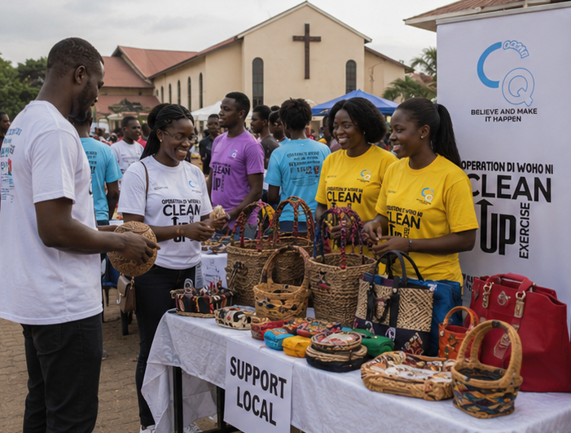


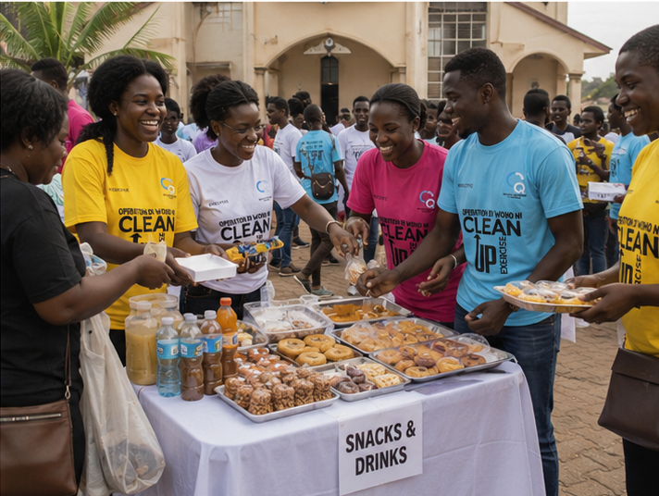
POST FLOAT EXHIBITION
COMMUNITY TOUR
REFRESHMENTS
THE FLOAT
NETWORKING

Slide 22


OPERATION DI WOHO NI FLOAT
Logistics and budget
Branded T-shirts
Banners and placards
Public address system
Pickup truck or float vehicle
Water and refreshments
First aid kit.
police/security
Printing of banners and flyers
Objectives
Introduce QQMA to the community.
Create awareness about the organization's mission and activities.
Attract members, partners, and sponsors.
Date and Time
DATE : 19TH SEPTEMBER,2026
TIME: 7:00 a.m. – 11:00 a.m.
FLOAT ACTIVITY
FLOAT TRUCK WILL CONVEY VOLUNTEERS THROUGH THE TARGET COMMUNITIES.
PROGRAMME SCHEDULE
Time | Activity
7:00 a.m. | Assembly and registration
7:30 a.m. | Opening prayer and briefing
8:00 a.m. | Float begins (ADENTA FOSTER HOME SCHOOL)
11:30 a.m. | Arrival at final destination
11:45 a.m. | EXECUTIVES ADDRESS AND REFRESHMENT/EXHIBITION
2:00 P.m. | Closing and refreshments

Slide 23

THE FLOAT BUDGET

Slide 24
QQMA FLOAT & PRODUCT EXHIBITION BUDGET
TOTAL BUDGET | ₵30,000.00
No. | Budget Item | Amount (GHS)
1 | Float truck/platform & decoration | ₵5,000.00
2 | Sound system, DJ & MC | ₵3,000.00
3 | Volunteer T-shirts (100) | ₵5,000.00
4 | Banners and branding | ₵2,000.00
5 | Flyers, posters & publicity | ₵1,500.00
6 | Volunteer transportation/logistics | ₵2,500.00
7 | Water & refreshments | ₵5,000.00
8 | TEAM LEADS TRANSPORT ALLOWANCE | ₵1,500.00
9 | Exhibition tables, canopies & display stands | ₵1,500.00
11 | Photography, videography & media coverage | ₵1,000.00
12 | Security & crowd management | ₵800.00
13 | First aid/emergency support | ₵500.00
14 | Communication & coordination | ₵700.00
 | TOTAL | ₵30,000.00

Slide 25

CLEAN UP EXERCISE BUDGET

Slide 26
Estimated Budget FOR A community
Total Estimated Cost: GHS 21,000
S/N | It1em Description | Quantity | Unit Cost (GHS) | Total Cost (GHS)
1 | Cleaning Brooms | 25 | 25 | 625
2 | Dustpans | 25 | 15 | 375
3 | Gloves (pairs) | 100 | 10 | 1,000
4 | Face Masks | 100 | 3 | 300
5 | Trash Bags | 300 | 1 | 300
6 | Wheelbarrows | 6 | 150 | 900
7 | Rakes | 15 | 40 | 600
8 | Water Buckets | 20 | 20 | 400
9 | Hand Sanitizer (500ml) | 10 | 35 | 350
10 | First Aid Kit | 2 | 150 | 300
11 | Brooms for sweeping leaves | 20 | 20 | 400
12 | Cleaning Soap / Detergent (kg) | 15 | 30 | 450
13 | Feeding (meals & drinks for 100 youth) | 100 | 45 | 1,500
14 | Souvenirs (T-shirts, caps, wristbands) | 100 | 100 | 10,000

Slide 27
OFFICIALS AND PARTNERSHIP APPROVALS
MUNICIPAL/DISTRICT
ENVIRONMENTAL PROTECTION AGENCIES(EPA)
COMMUNITY CHIEFS
POLICE
SPONSORS AND PARTNERS
OLD MUTUAL
BUZ STOP BOYS
MTN
ZOOM LION
SCHOOLS AND CHURCHES
HARLEQUIN INTERNATIONAL
NGOS
LOCAL BUSINESSES
PEEVA
SPECIAL SUPPORT
truck for float
dust bins
gloves
reflective jackets
water
food
first aid
PA system

Slide 28
OPEN FORUM
QUESTIONS AND RESOLUTIONS

Slide 29
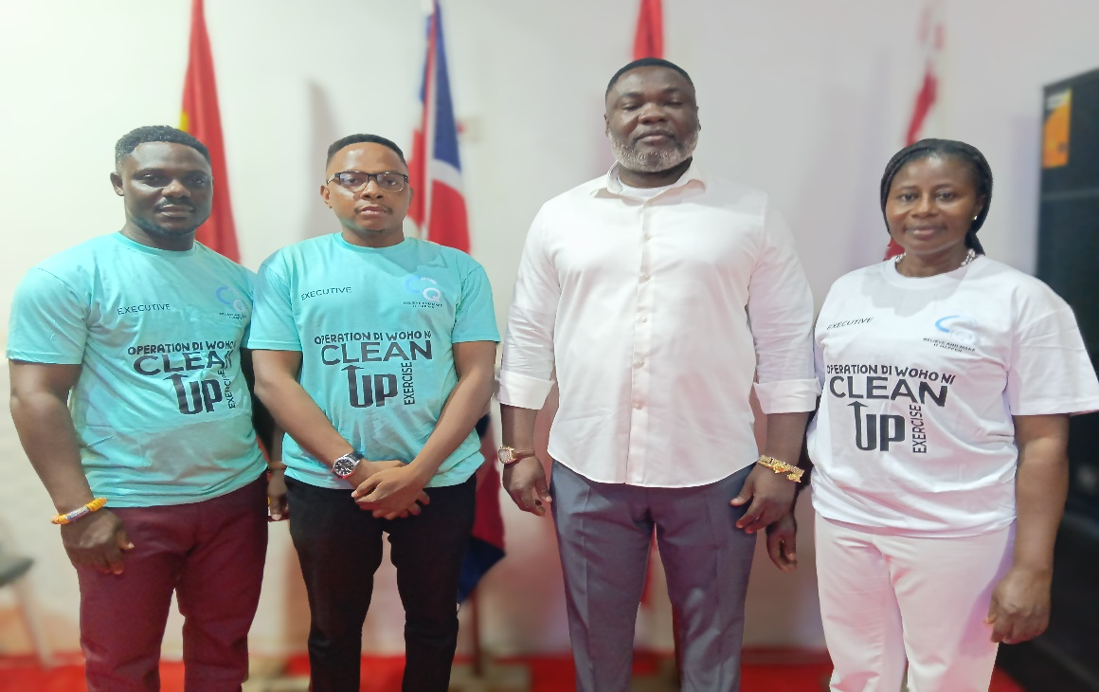
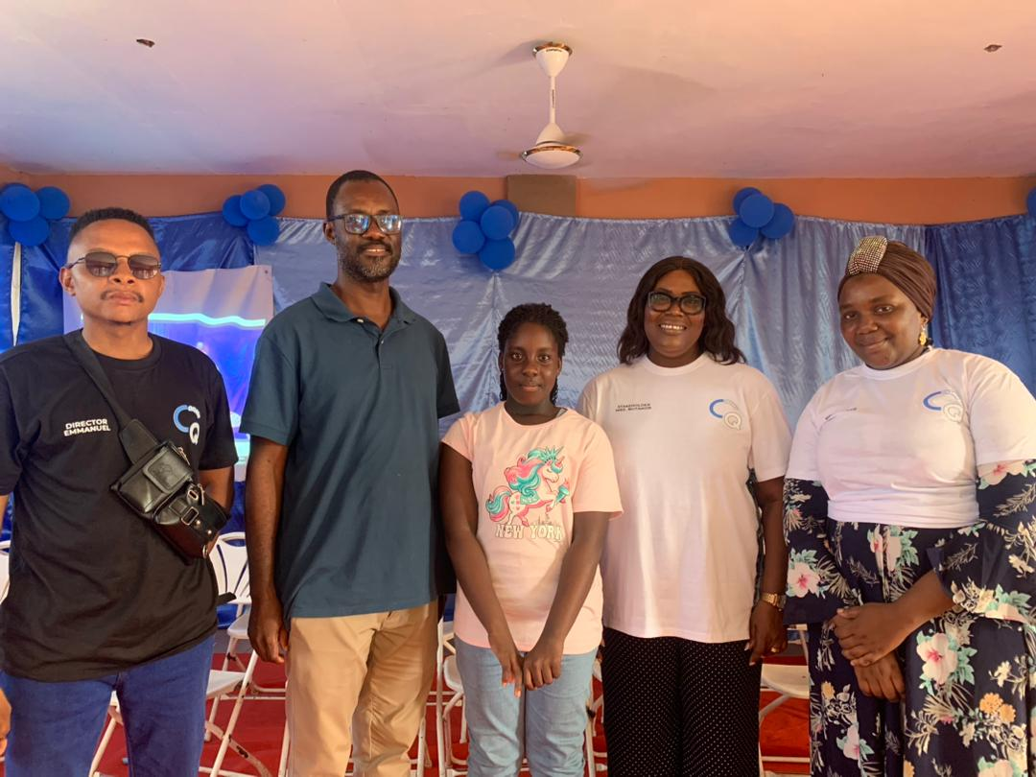
QQMA TEAM 2026
PATRONS AND STAKEHOLDERS
1.MR.PRINCE LARTEY
2. MRS.NUTAKOR
3.MRS ELSIE KLU
4.DR. MRS HEATHER BOCTWAY
5.MRS AISHA
BOARD MEMBERS AND EXECUTIVES
PRESIDENT - EMMANUEL FRENCH
VICE PRESIDENT – ADJA ANUM NATHANIEL
SECRETARY –DORIS ADU- BEKOE
HEAD OF OPERATIONS – SOLOMON COLEMAN
PUBLIC RELATIONS OFFICER – AARON NAI
6. INTERNATIONAL RELATIONS – PHILIP ADDO

Slide 30

Thank you
Qqma
BELIEVE AND MAKE IT HAPPEN
Tel:0551392267/0502905292
Location: Adenta Frafraha
QQMA STUDIOS

